Slide 1

DriverPass System Analysis
Yancarlo Guzman
Notes:
[No speaker notes required for this slide.]

Slide 2

System Requirements
Functional Requirements:
The system will track user activity, including reservations, cancellations, and modifications, and provide an audit trail.
The system must interact with the DMV to keep up to speed on current regulations, policies, and example questions, as well as notify users of any modifications or changes.
Non-Functional Requirements:
The system should run fast enough to ensure a seamless user usage experience with pages loading at reasonable time frames ideally less than 3 seconds.
System updates should be a regular occurring thing, to consistently fix bugs and keep security up to date. Updates should be regular scheduled and communicated so that users know in advance to avoid disruptions.
Notes:
Functional requirements:
The system will monitor user behavior, such as reservations, cancellations, and updates, and will provide an audit trail to ensure responsibility. This fits DriverPass's requirements by guaranteeing openness and accountability in user interactions, which is critical for efficiently organizing driving lessons and examinations.
Interacting with the DMV to get updated rules, procedures, and sample questions is critical for DriverPass. This capability guarantees that users have access to current material, which improves the quality of their learning experience and appropriately prepares them for tests.
our system's non-functional needs are critical for assuring its performance and maintenance.
Performance requirement:
The first non-functional criteria concerns performance. Our system must function quickly in order to give users with a smooth experience. We specifically aim for sites to load in under 3 seconds. This guarantees that consumers can utilize our site efficiently and without experiencing annoying delays.
Maintenance requirements:
Next, let's talk about system updates. It is critical that we keep our system up to date in order to fix issues and maintain security. We must execute regular upgrades to guarantee maximum performance and protect user data. To minimize interruptions, these upgrades should be planned on a regular basis and informed to users in advance.

Slide 3
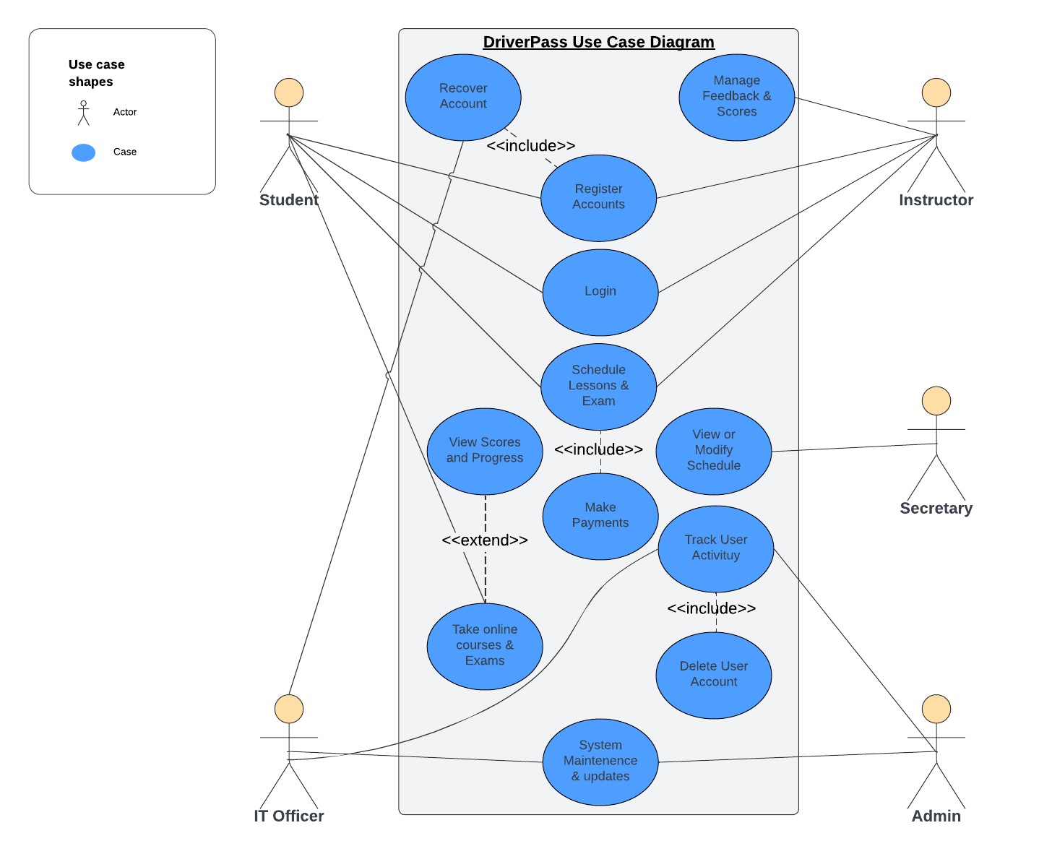
Use Case Diagram
.
Notes:
Actor Roles:
Within our system, we have five key actors, each with distinct roles and responsibilities:
Student: Engages in essential tasks like registration, login, scheduling lessons, and taking exams, forming the core user interactions.
Instructor: Holds the responsibility of managing scores, as well as scheduling lessons and exams to ensure smooth educational operations.
IT Officer and Admin: Hold comprehensive control over the system, tasked with tracking user activity, and ensuring system updates and maintenance are executed timely and effectively to uphold security and performance standards.
Secretary: Plays a crucial role in simplifying administrative tasks, such as rescheduling appointments and addressing schedule-related queries, thereby supporting operational efficiency.
Conclusion:
By comprehending the distinct roles and interactions depicted in the use case diagram, we can optimize user experience, enhance system functionality, and ensure efficient operations of the DriverPass platform.

Slide 4
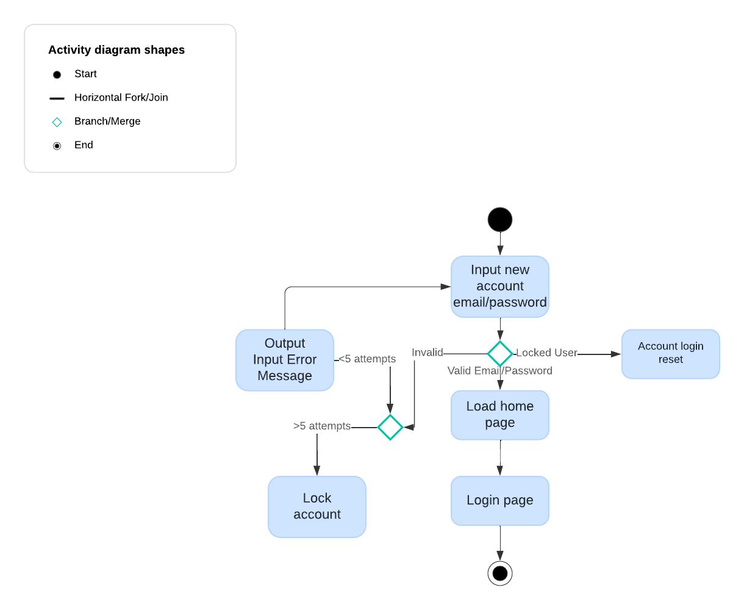
Activity Diagram
.
Notes:
This is one of our activity diagrams, showcasing the login scenario within the DriverPass system. It's a straightforward process:
You begin by entering your email and password. If there's an error, we offer a chance to correct it or reset your account. If your credentials are correct, you're swiftly directed to the home page.
But what if your account is locked? No worries. We provide a simple solution, reset your password using your registered email.
Our design prioritizes user experience and security, ensuring a smooth login process for all DriverPass users.

Slide 5
Security
Security
What is required for the user to log in? How can we secure the connection or the data exchange between the client and the server? What should happen to the account if there is a “brute force” hacking attempt? What happens if the user forgets their password?
User authentication will require both of username and password, with strong password policies and requirements enforced to enhance security.
Data exchange between the client and server should use encryption with industry-standard protocols like HTTPS to safeguard sensitive private information.
If there is a brute force hacking attempt, the system should implement measures such as account lockout after multiple consecutive failed login attempts to prevent unauthorized access.
In the case a user forgets their password, the system will need to provide a secure password reset mechanism, like sending a reset link to the user's registered email address.
Notes:
Security Considerations:
When it comes to security, we've taken several measures to ensure the safety of user accounts and data exchange within the DriverPass system.
User Authentication: To log in, users must provide both their username and password. We enforce strong password policies to bolster security and protect against unauthorized access.
Data Encryption: We prioritize the security of data exchange between clients and servers. Utilizing industry-standard protocols like HTTPS ensures that sensitive information remains encrypted, safeguarding it from interception by unauthorized parties.
Preventing Brute Force Attacks: In the event of a "brute force" hacking attempt where an attacker systematically tries different password combinations, the system reacts swiftly. After multiple consecutive failed login attempts, the account is automatically locked out, thwarting unauthorized access attempts.
Password Recovery Mechanism: Should a user forget their password, we've implemented a secure password reset mechanism. By sending a reset link to the user's registered email address, we enable them to regain access to their account securely and efficiently.
These security measures are integral to our design, prioritizing the protection of user accounts and sensitive data, and ensuring a safe and reliable experience for all DriverPass users.

Slide 6
System Limitations
Limitations
Any system you build will naturally have limitations. What limitations do you see in your system design? What limitations do you have as far as resources, time, budget, or technology?
Limited budget and resources for this system may impact the depth and scope of its features and functionalities.
Time constraints may require that we prioritize essential features over extra enhancements or optimizations.
Technological limitations may possibly arise from compatibility issues with older outdated systems or perhaps constraints enacted by third-party integrations.
Notes:
Every system has its constraints, and we're mindful of ours within the DriverPass design.
Budget and Resources: Our system's capabilities may be affected by budget and resource limitations. This could impact the breadth and depth of features we can offer.
Time Constraints: Time is another factor we consider. We may need to prioritize essential features over additional enhancements due to time constraints.
Technological Constraints: Compatibility issues with older systems or limitations imposed by third-party integrations could pose challenges. We're prepared to address these as they arise, ensuring smooth functionality for our users.
Despite these limitations, we remain committed to delivering a secure and user-friendly experience within the constraints of our resources, time, budget, and technology.

